Slide 1

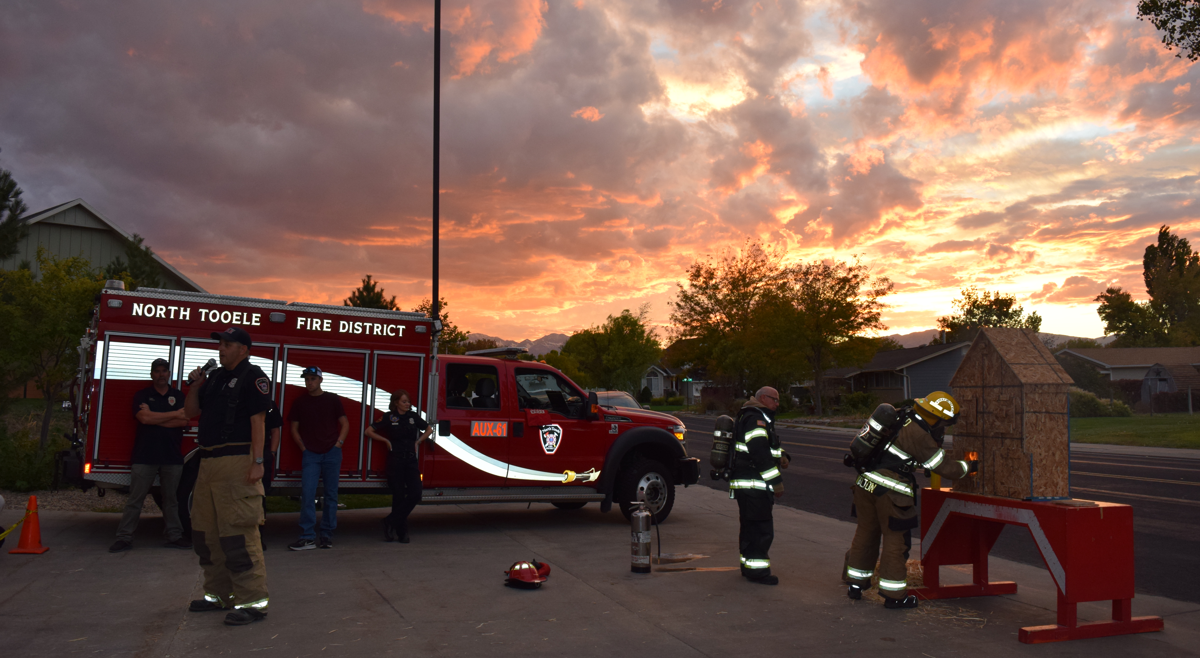
North Tooele Fire District
Board Presentation December 2025

Slide 2
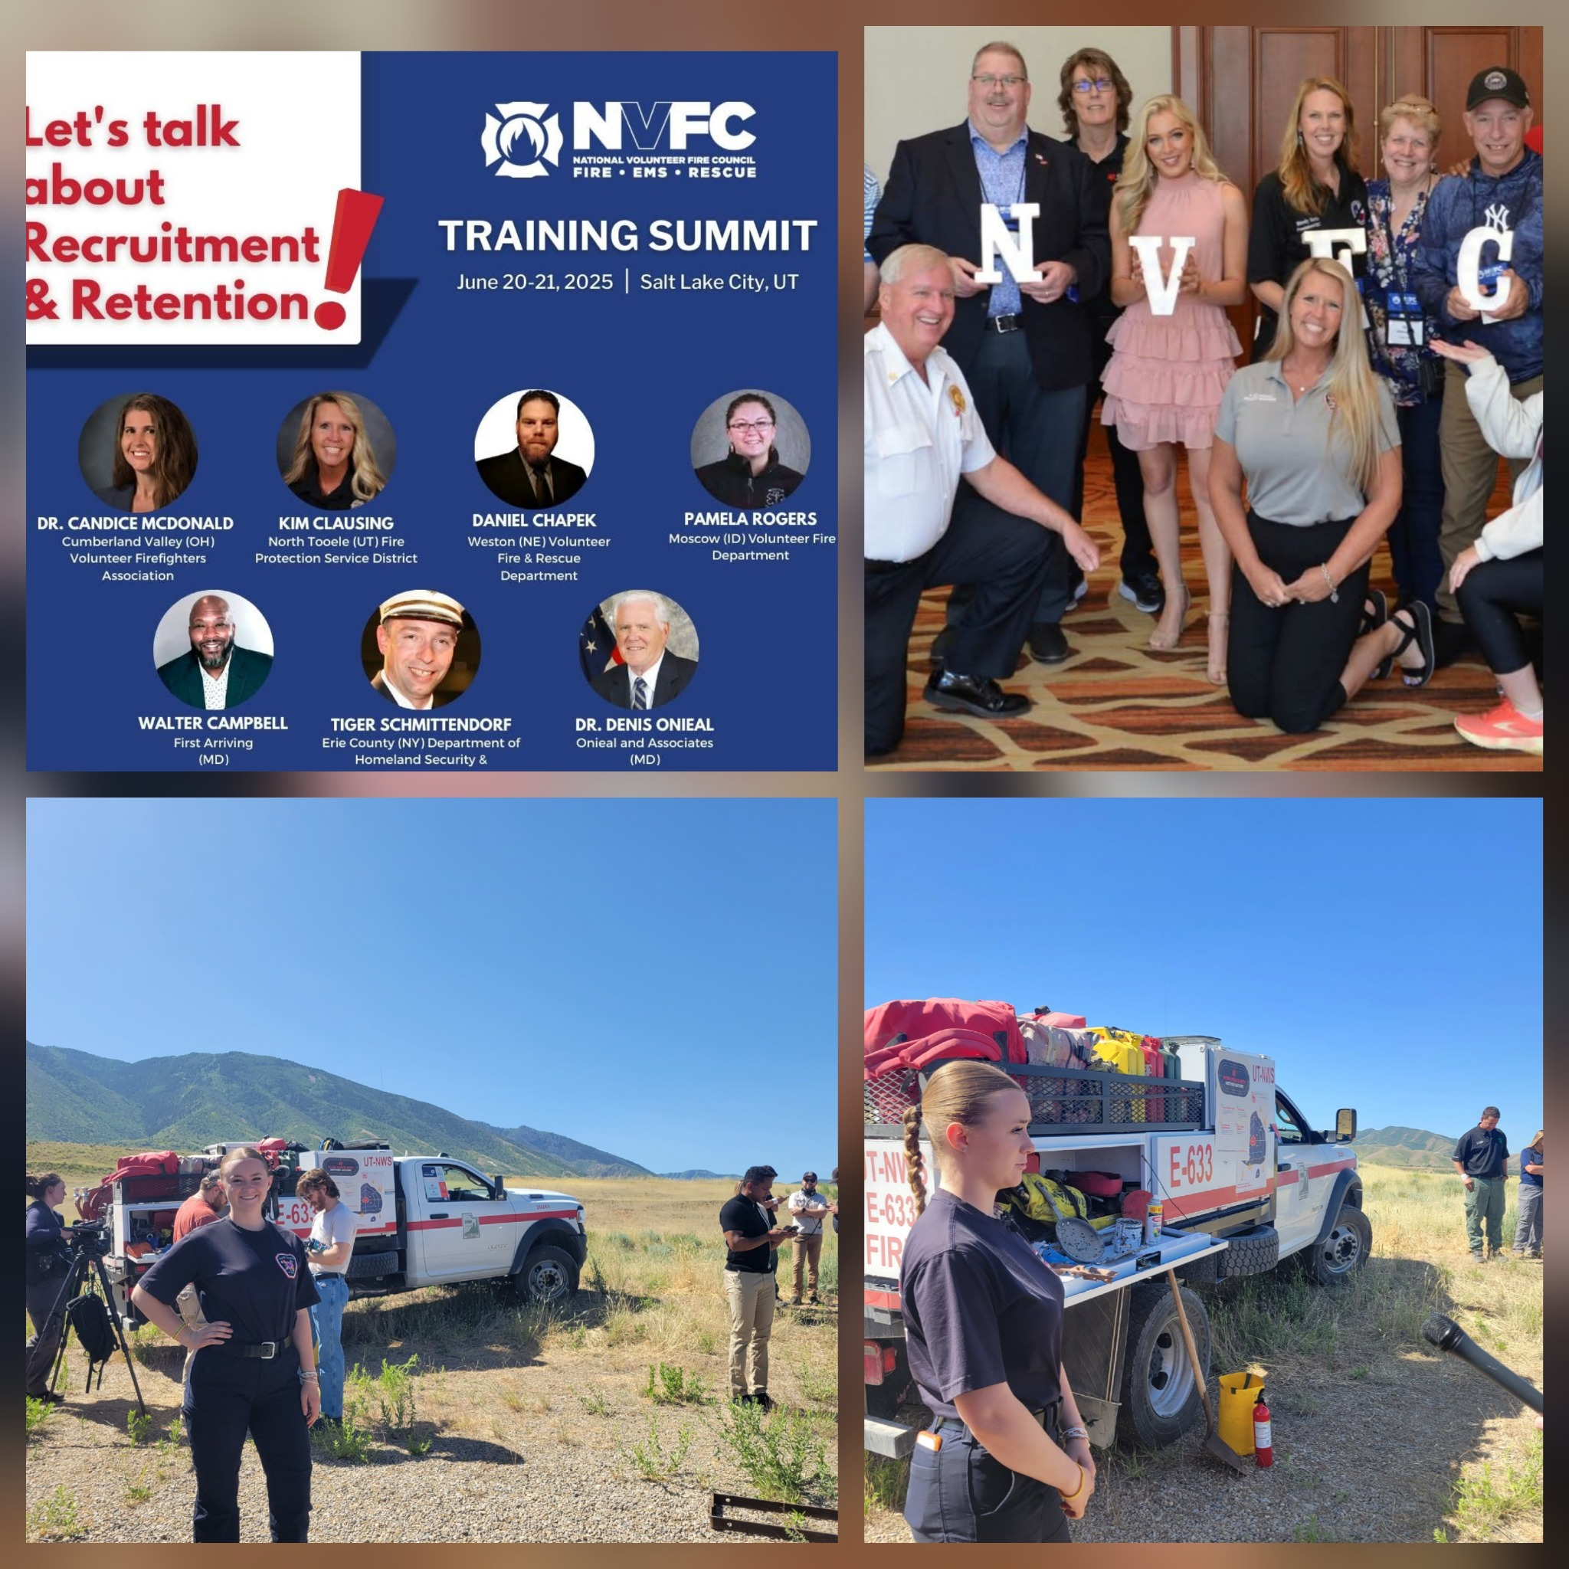
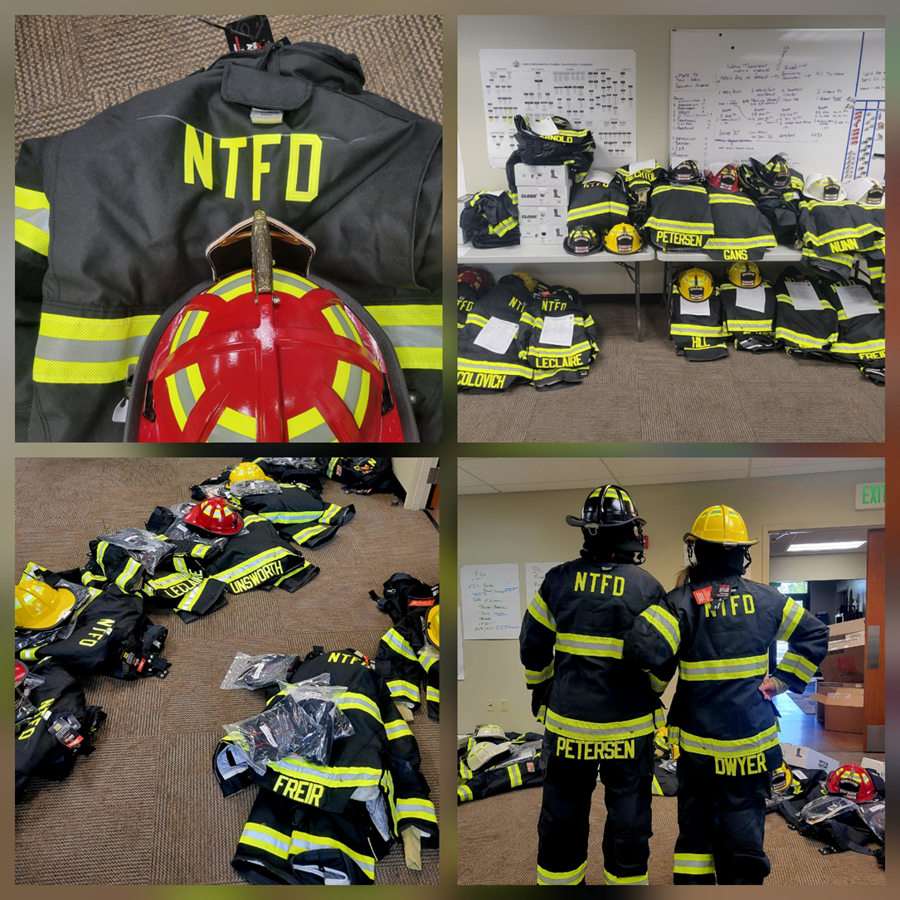
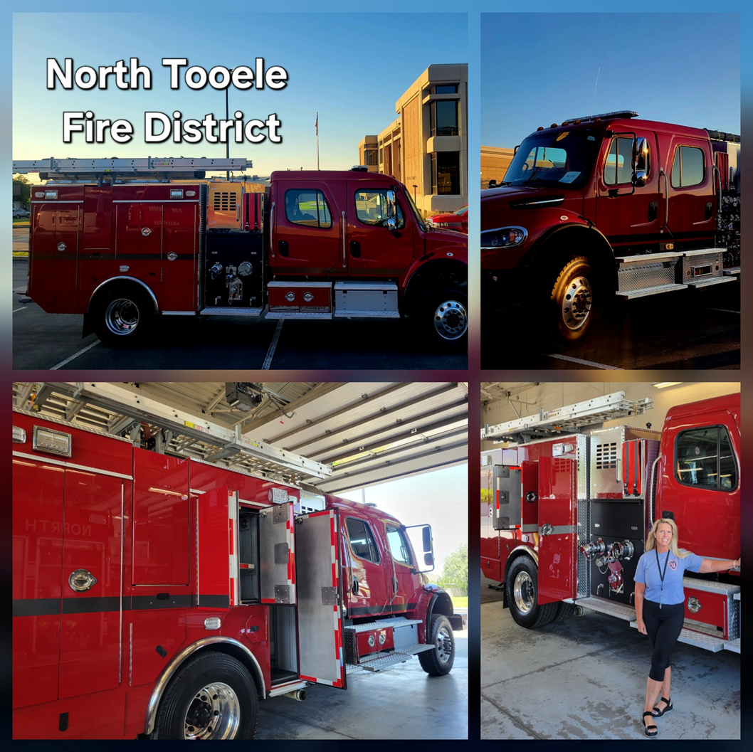
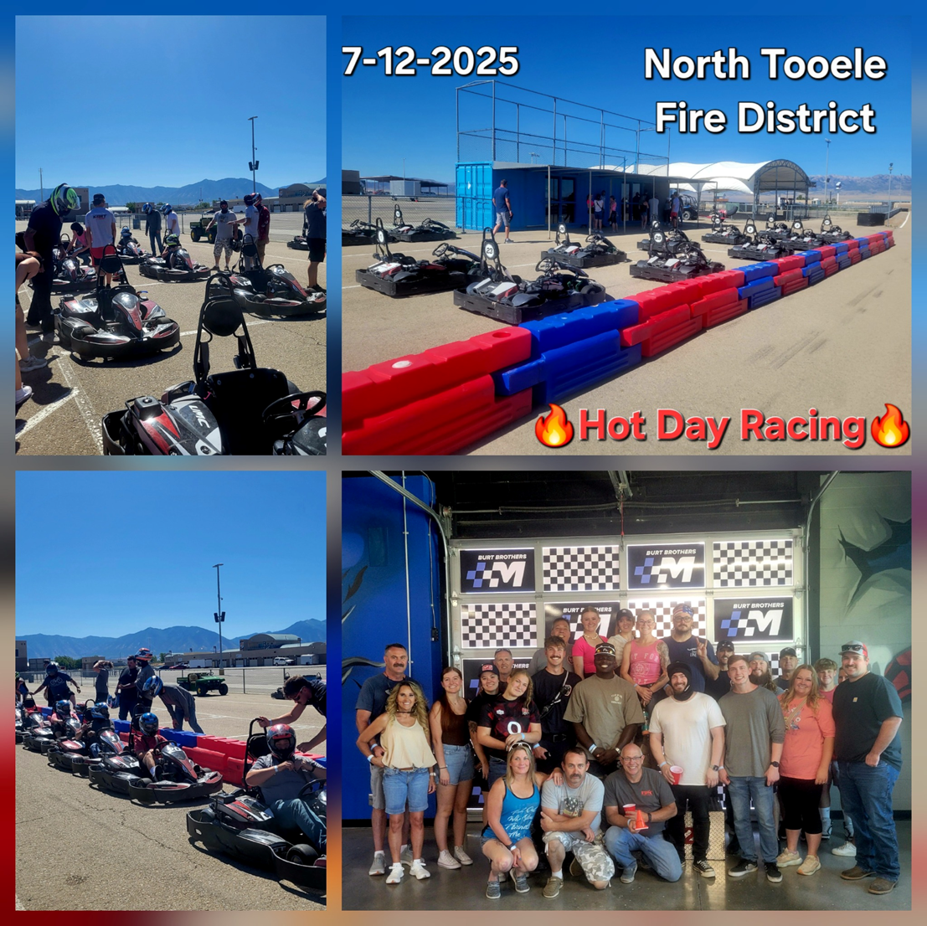

Slide 3
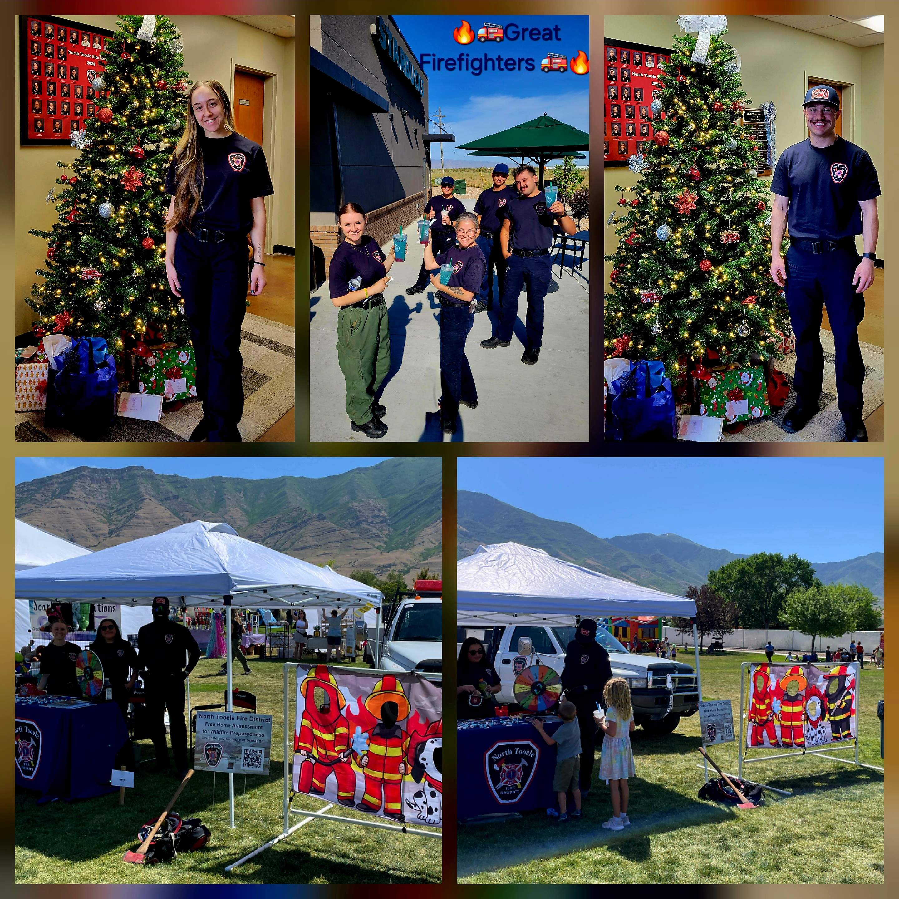
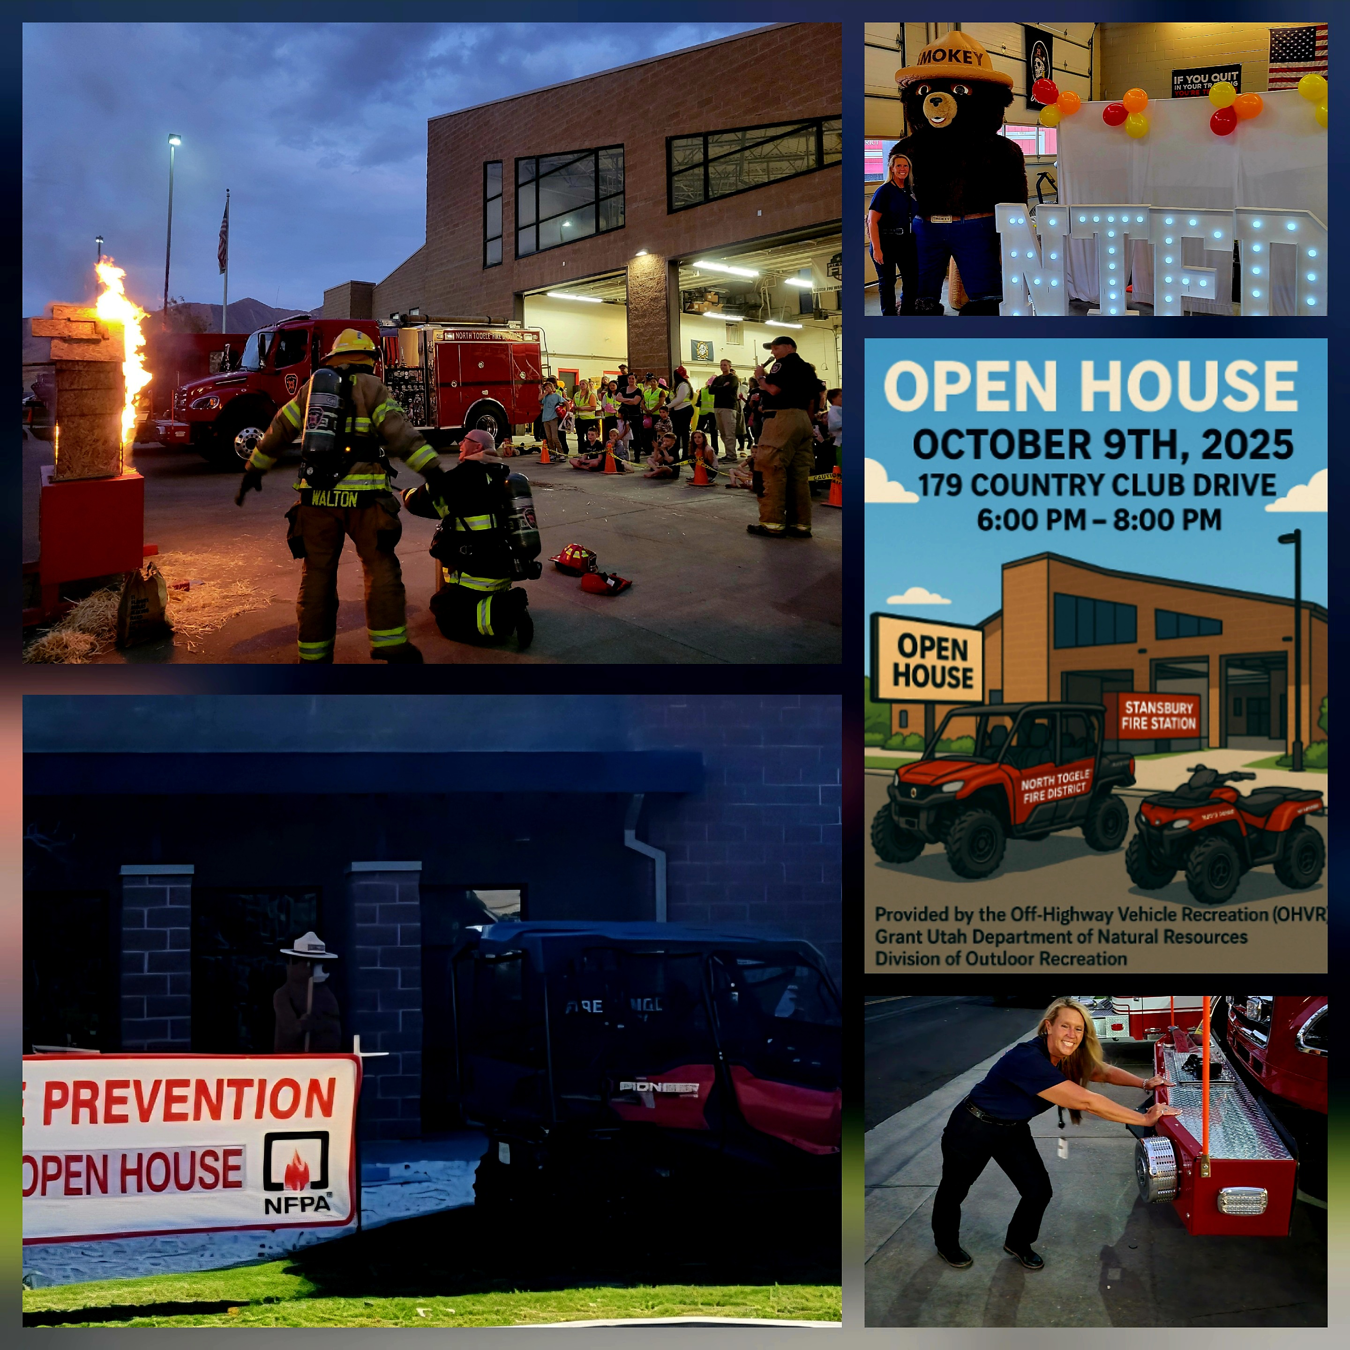
11 New
Volunteers
this Fall
Events &
Open House
Seasonals &
Volunteer Help

Slide 4
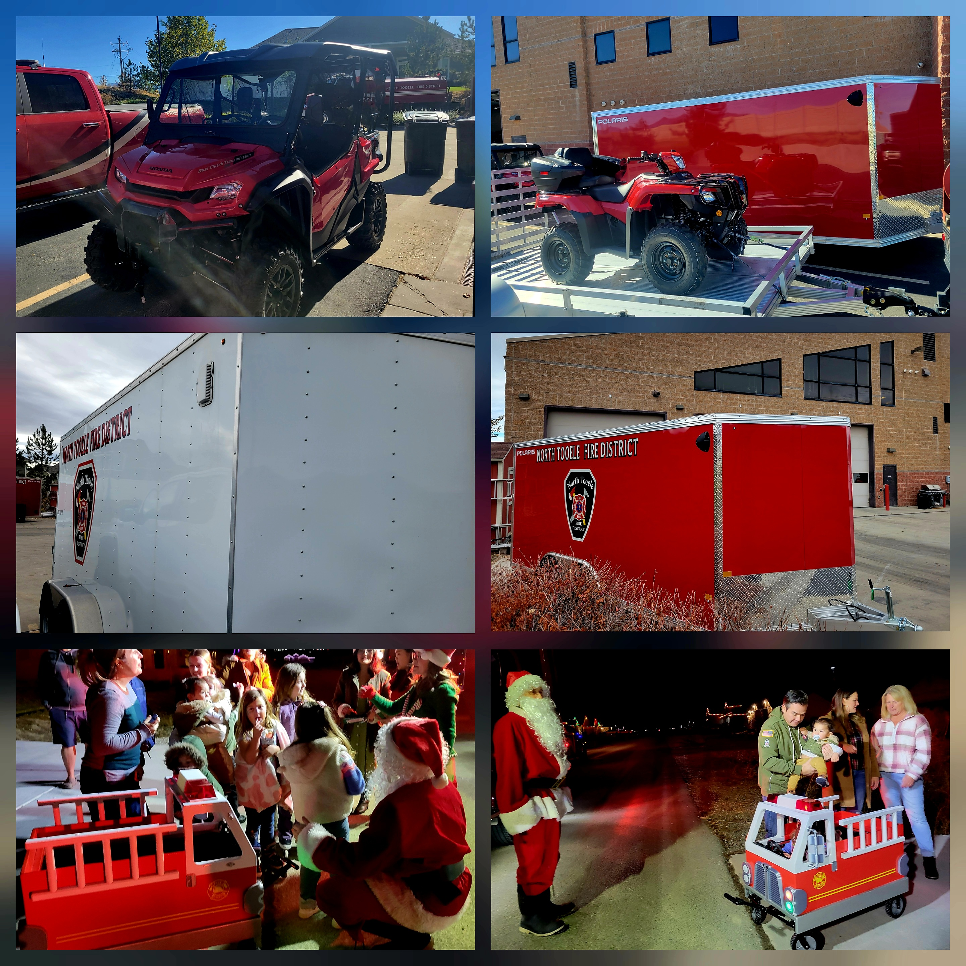
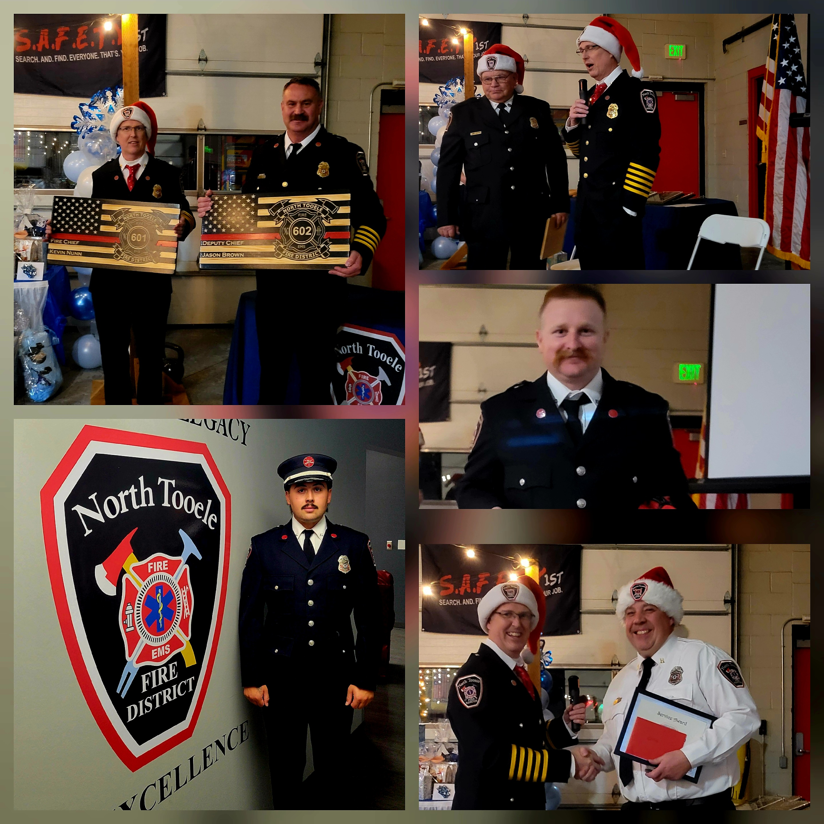
SAFER Grant
Class A Uniforms
Side by Side,
4 Wheeler & 2 Trailers
Working on
Ladder Truck

Slide 5
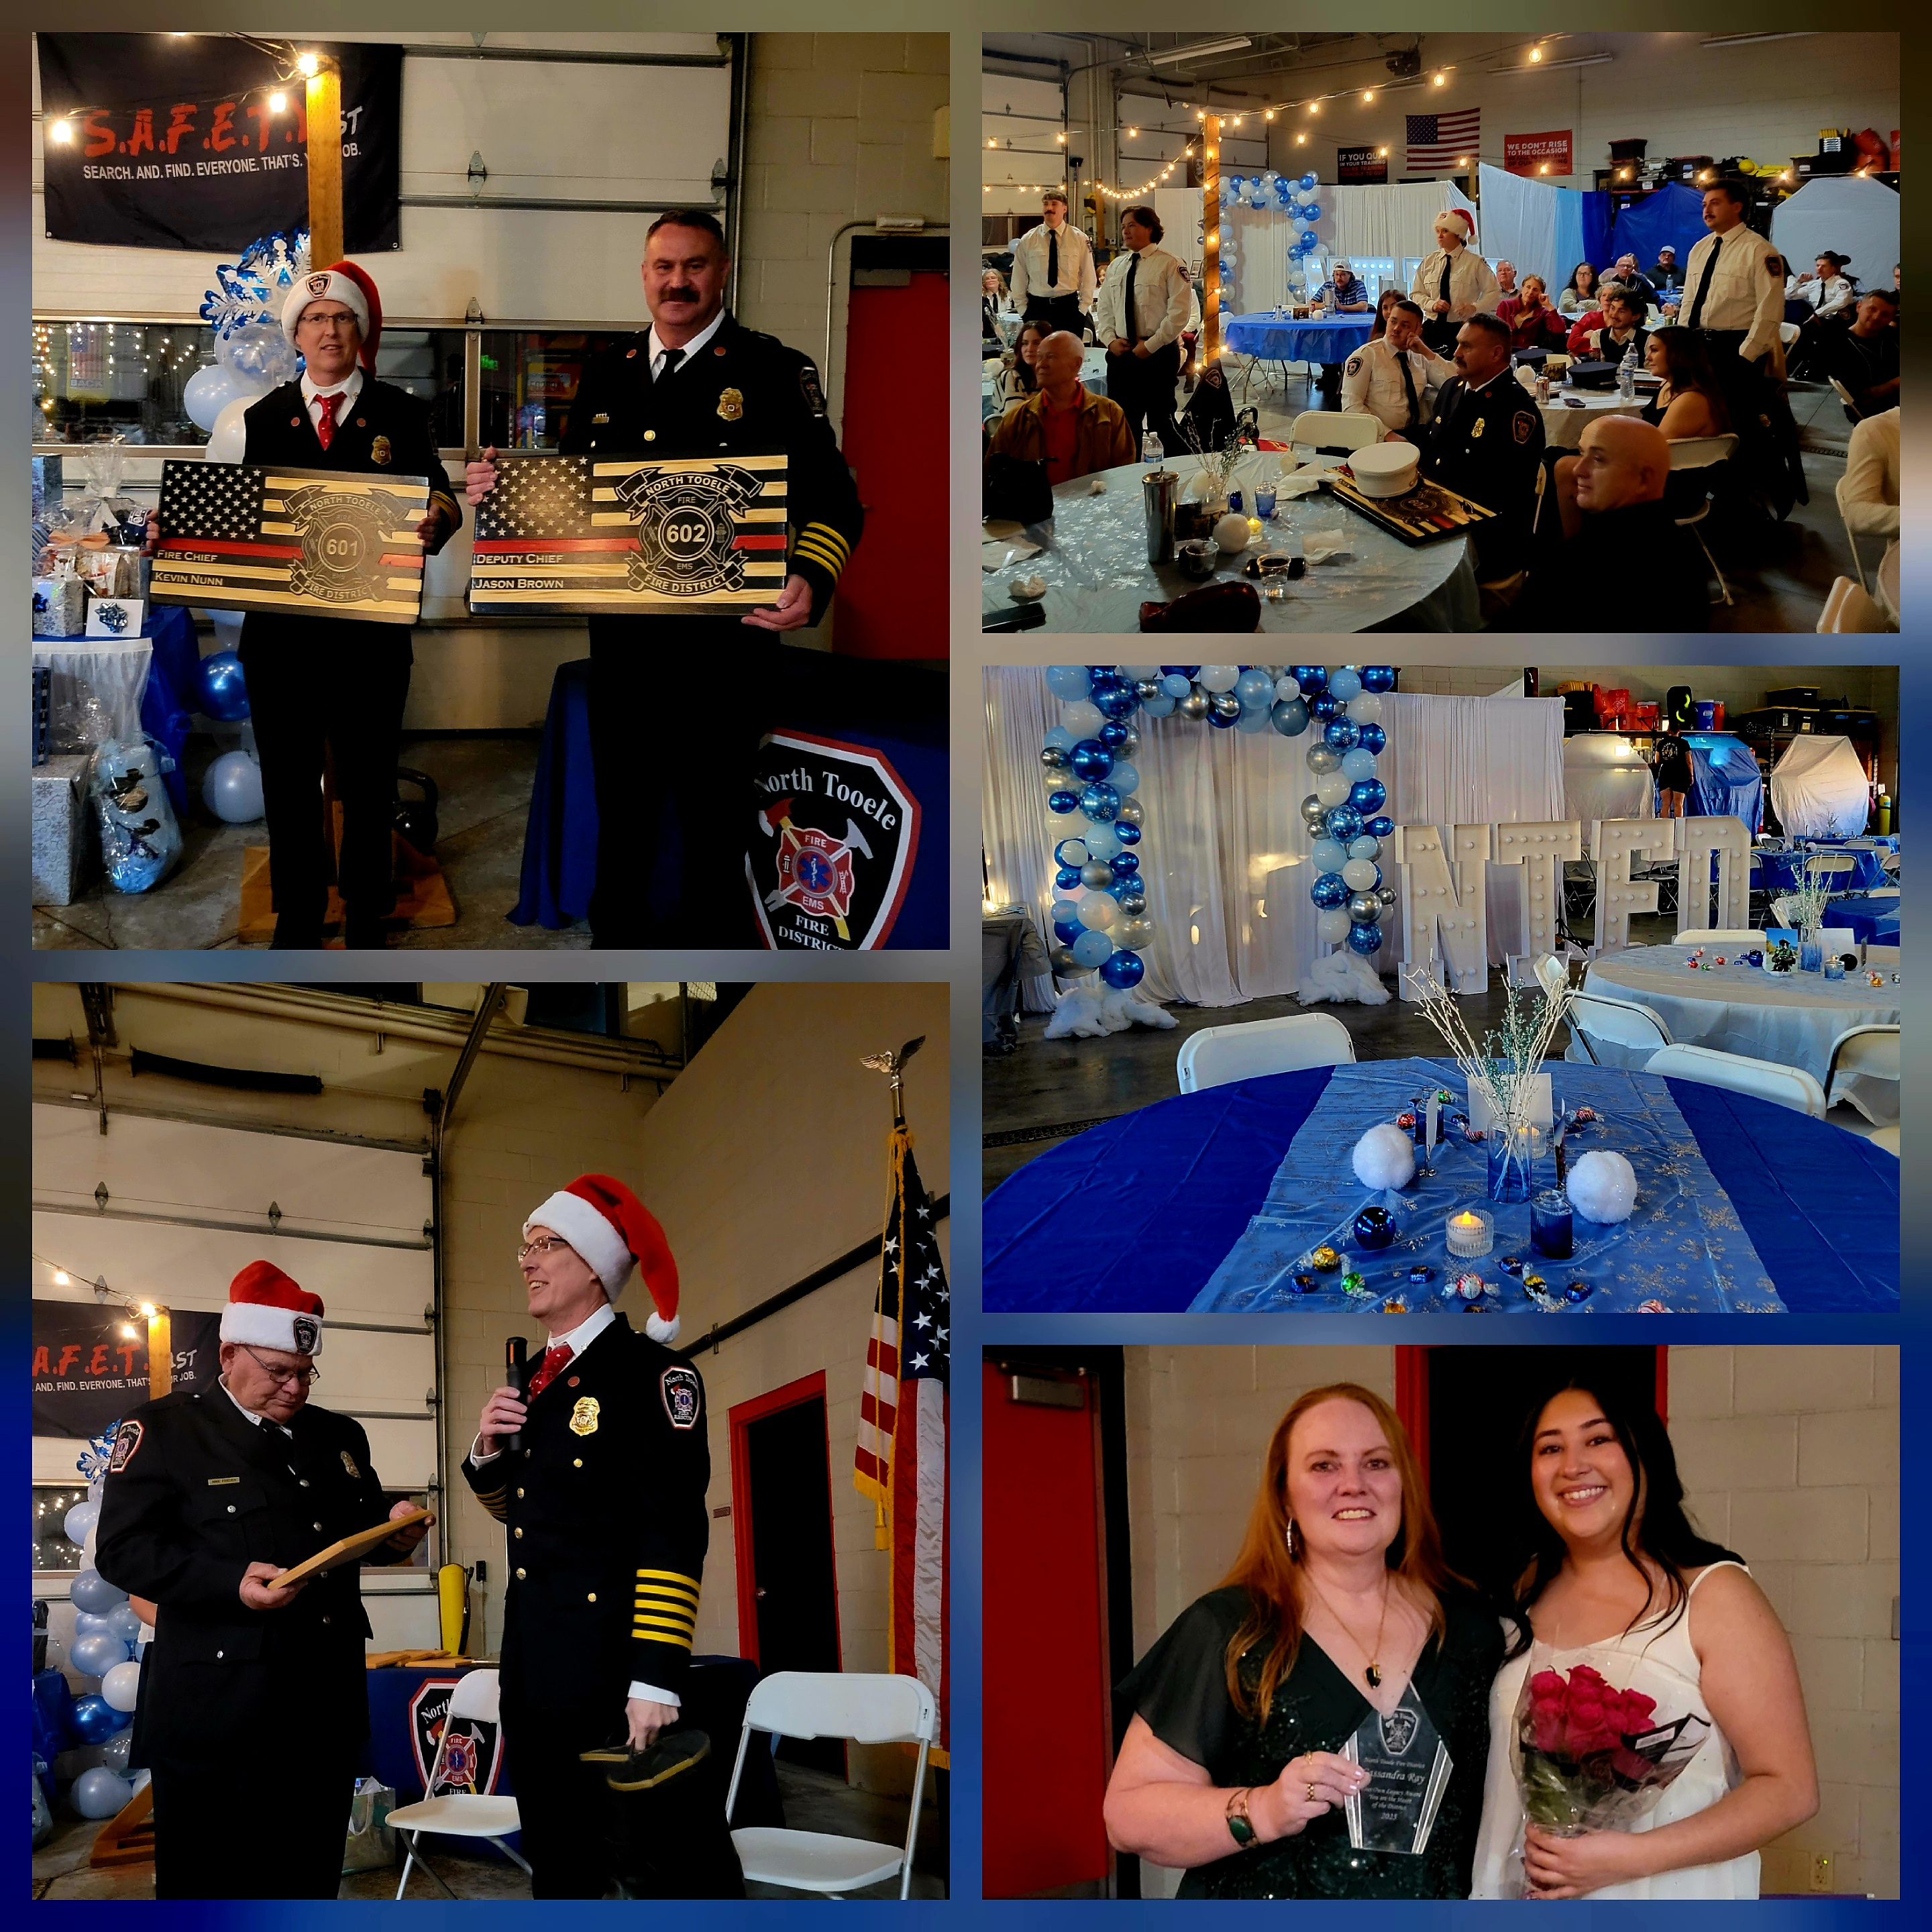
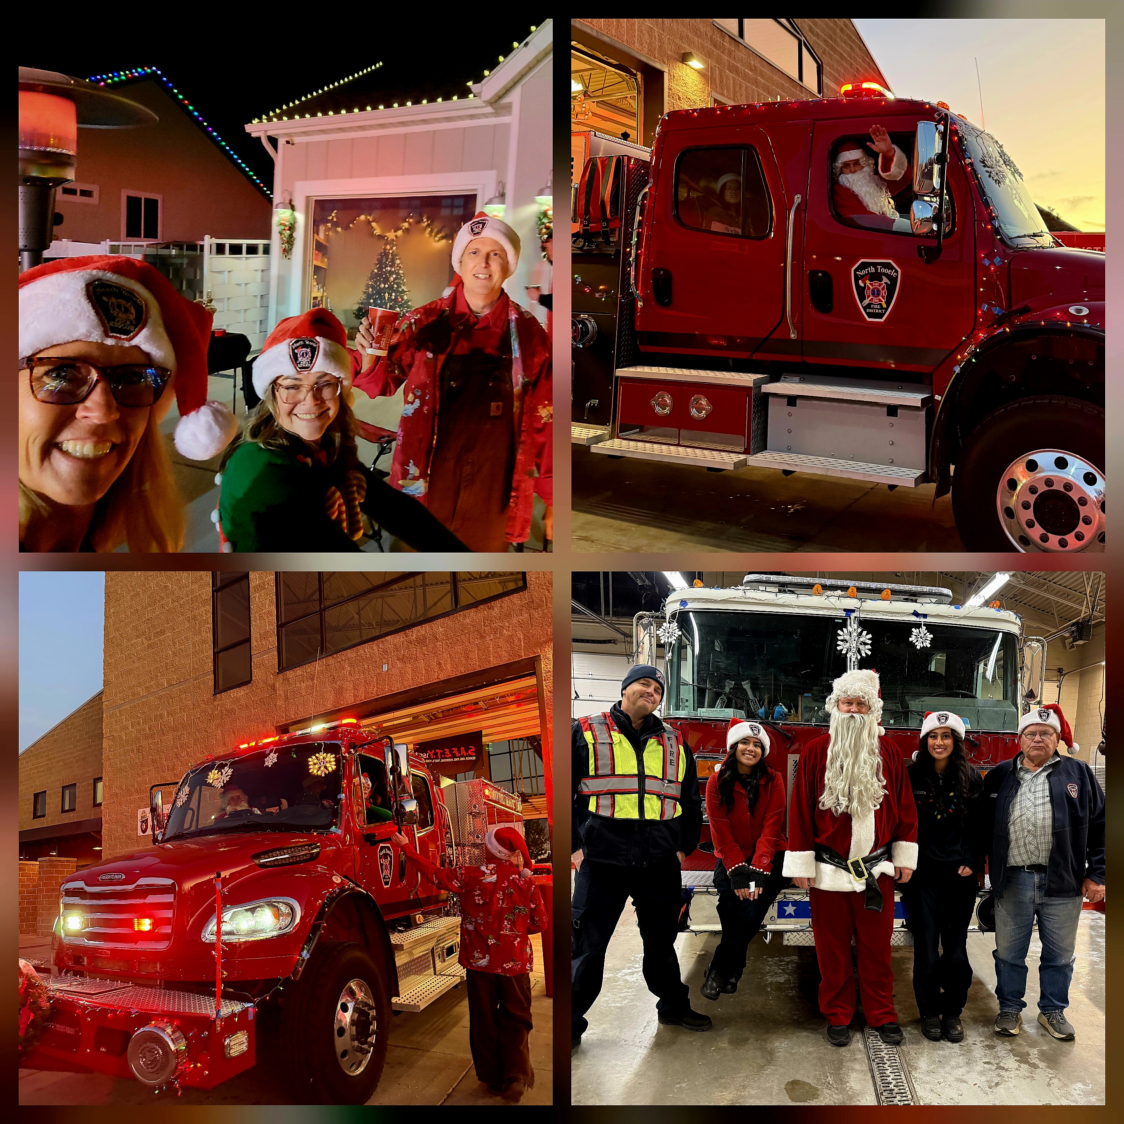
North Tooele
Fire District’s
Great Team
Plans in place and if
the momentum sticks,
even more to come
in 2026

